Slide 1
Tinkering Bootcamp
By- Tinkerers Lab

Slide 2
Course Overview
Week 1:Introduction to Arduino, Sensors, Modules, Quiz & Challenge 1
Week 2:Introduction to NodeMCU and ESP32, Voice Assistant
Week 3:Zigbee, Swarm networking, Chatbot, Project
Week 4:Fundamentals of Raspberry Pi and its application
Week 5: Project 2 and Talks

Slide 3
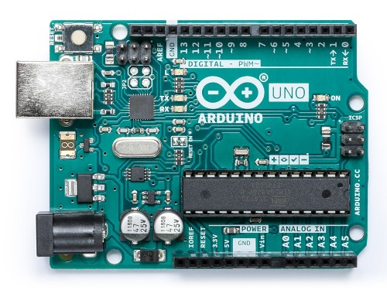
Arduino
Arduino Uno is a microcontroller board based on the ATmega328P. It has 14 digital input/output pins (of which 6 can be used as PWM outputs), 6 analog inputs, a 16 MHz ceramic resonator (CSTCE16M0V53-R0), a USB connection, a power jack, an ICSP header and a reset button.

Slide 4
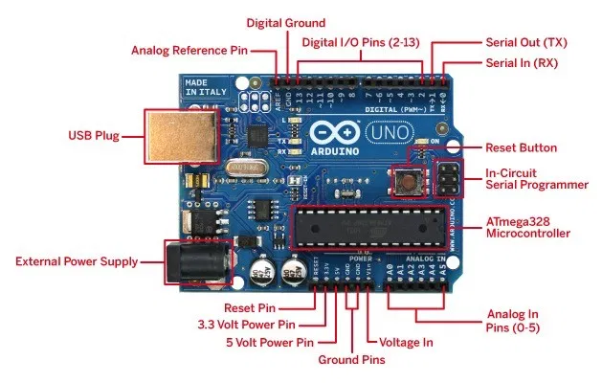
GPIO Pins(General Purpose Input Output)
PWM Pins(Pulse Width Modulation)

Slide 5
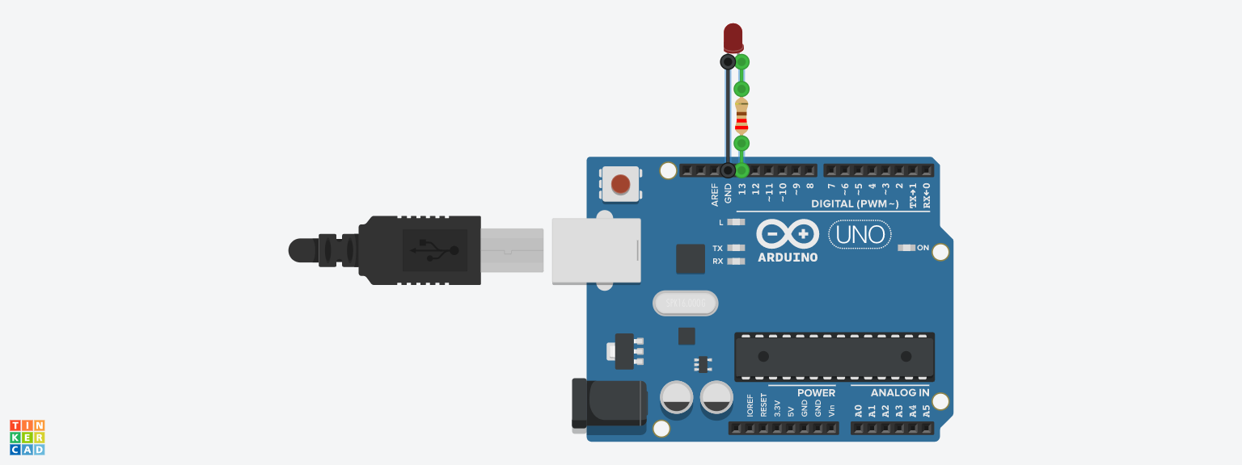
Demo Of Blinking LED Digital Pin

Slide 6
Code for Blinking of LED
This program blinks pin 13 of the Arduino (the
built-in LED)
*/
void setup()
{
pinMode(13, OUTPUT);
}
void loop()
{
// turn the LED on (HIGH is the voltage level)
digitalWrite(13, HIGH);
delay(1000); // Wait for 1000 millisecond(s)
// turn the LED off by making the voltage LOW
digitalWrite(13, LOW);
delay(1000); // Wait for 1000 millisecond(s)
}

Slide 7
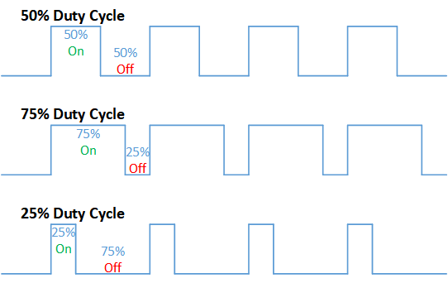
PWM
Pulse-width modulation (PWM), or pulse-duration modulation (PDM), is a method of reducing the average power delivered by an electrical signal, by effectively chopping it up into discrete parts.
Vout = Vmax * Duty Cycle
A call to analogWrite() is on a scale of 0 - 255, such that analogWrite(255) requests a 100% duty cycle (always on), and analogWrite(127) is a 50% duty cycle (on half the time)

Slide 8
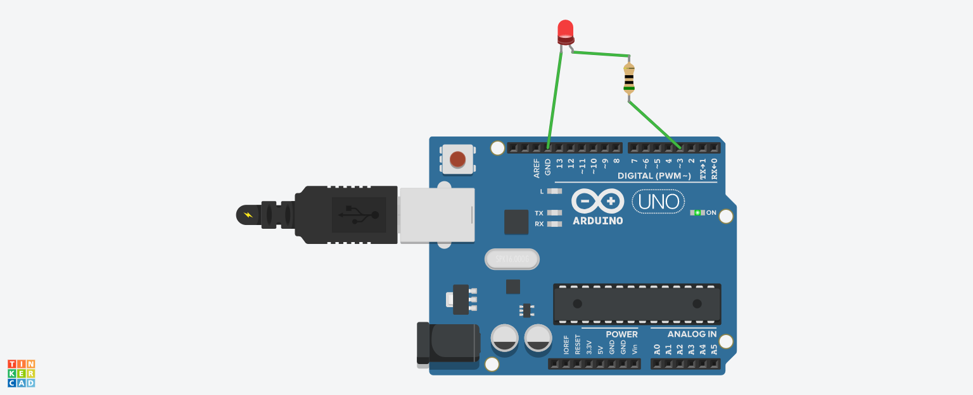
Demo of Led using PWM Pins

Slide 9
Code for Led glowing with varying brightness
int led=3;
byte pwmValue=0;
void setup()
{
pinMode(led, OUTPUT);
}
void loop()
{
analogWrite(led,pwmValue);
delay(20);
pwmValue++;
}

Slide 10
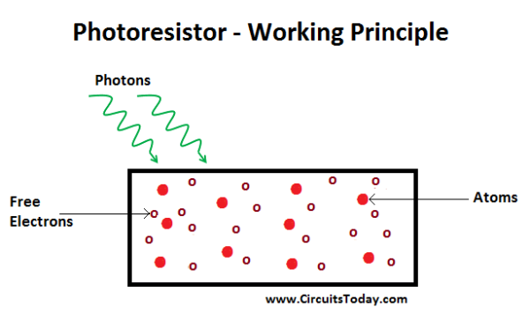
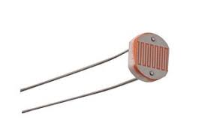
Photo Resistors
They are the resistors whose resistance is inversely proportional to the light intensity. As the light energy falling on the photoconductive material increases, number of valence electrons that gain energy and leave the bonding with the nucleus increases. This leads to a large number of valence electrons jump to the conduction band, ready to move with an application of any external force like an electric field.

Slide 11
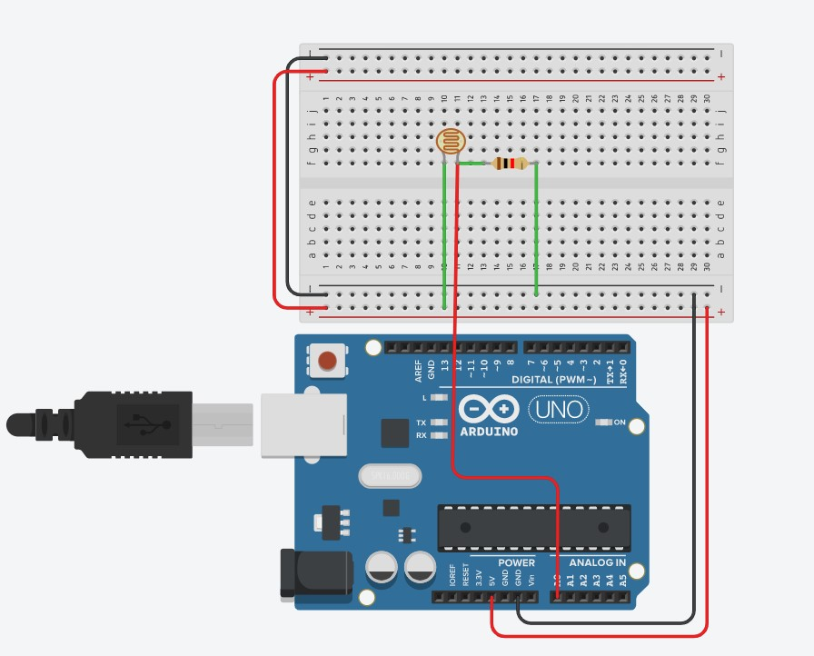
Demo of A photoresistor

Slide 12
Code For Photoresistors:-
void setup()
{
pinMode(A0, INPUT); //We are taking voltage input at pin A0
Serial.begin(9600); //Setting up serial monitor baud rate
}
void loop()
{
Serial.println(analogRead(A0)); //Printing the values after
delay(10); //interval of 10 milliseconds
}

Slide 13
Extra Resources
Blinking of LED in TinkerCAD-https://www.youtube.com/watch?v=yyG0koj9nNY -
Digital and analog signals
https://www.guru99.com/analog-vs-digital.html
PWM signals https://www.youtube.com/watch?v=GQLED3gmONg
https://youtu.be/ISzRh5eN_Pg
Photoresistors- https://www.youtube.com/watch?v=2fvXW4OEWLE

